Slide 1

AI-Powered User's Guide
June 2025

Slide 2



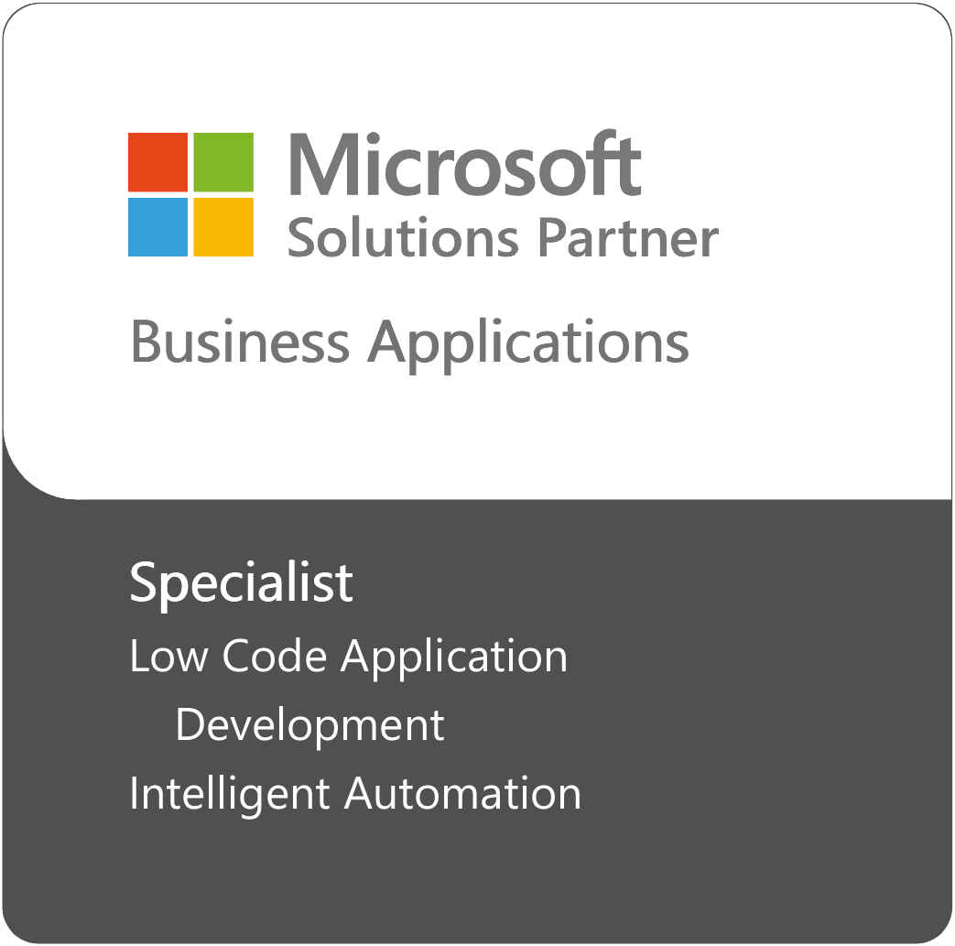














Why EPAM is the Best Implementation Partner for Power Platform
Microsoft D365 and
Power Platform Practice
Key Facts
Broad Expertise
14
150+
150+
100+
Power Apps
Power Automate
Copilot Studio
Power Pages
YEARS ON MARKET
CONSULTANTS & ENGINEERS
CERTIFIED SPECIALISTS
PROJECTS
Selected Clients
LIFESCIENCE & HEALTHCARE
BANKING & FINANCIAL SERVICES
INSURANCE
OIL & GAS
RETAIL
OTHER

Slide 3
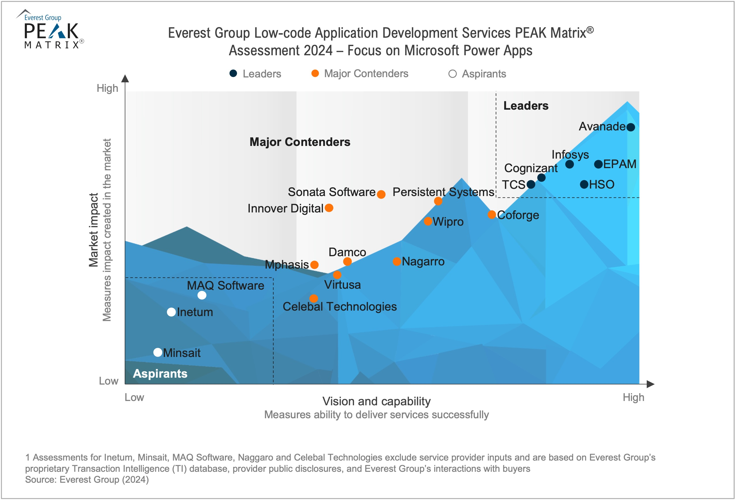
EPAM is Named Leader in Low-code Application Development Services Assessment 2024 by Peak Matrix
Everest Group's PEAK Matrix Assessments provide enterprises with essential analysis to help make informed choices regarding global service providers, locations, and products in various market segments.
Notes:
https://www2.everestgrp.com/reportaction/EGR-2024-32-R-6705/Marketing

Slide 4



We’re Empowering Your Business with Copilot Studio AI-Powered Solutions
EMPLOYEE ONBOARDING
SOFTWARE AND TECHNOLOGY ADOPTION
CUSTOMER SUPPORT AND SERVICE
Streamline the onboarding process for new hires across various departments by providing interactive, step-by-step guidance tailored to their specific role and department
Facilitate smoother transitions when rolling out new software or technologies within the company by providing employees with instant access to interactive guides and troubleshooting support
Enhance customer service by integrating the guide into customer support systems to provide real-time, step-by-step assistance to customers, reducing wait times and improving customer satisfaction
Notes:
Olga – Description of the case, 1 example for each feature.
Customer Service – how it may change BOI transparency - Borenkov

Slide 5




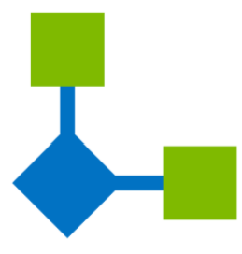
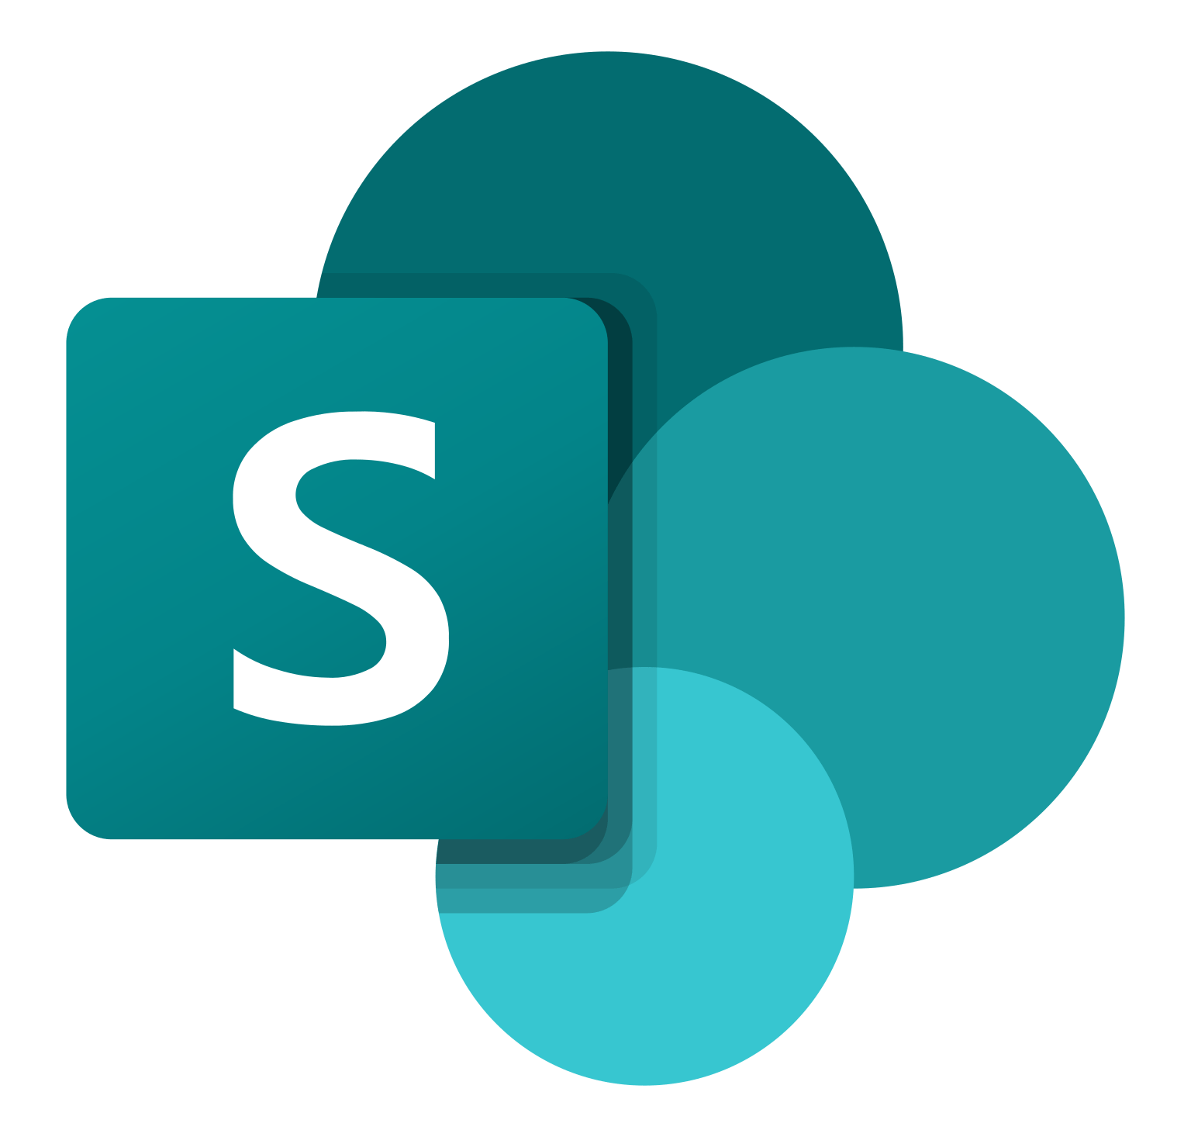
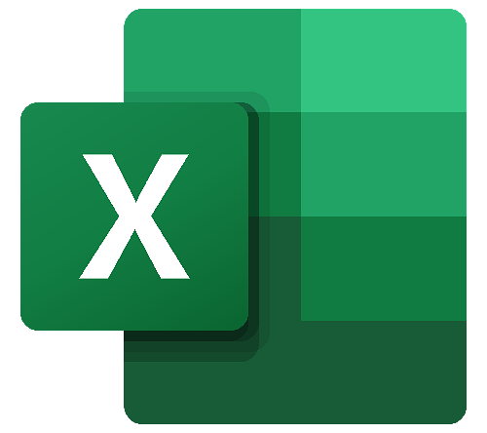


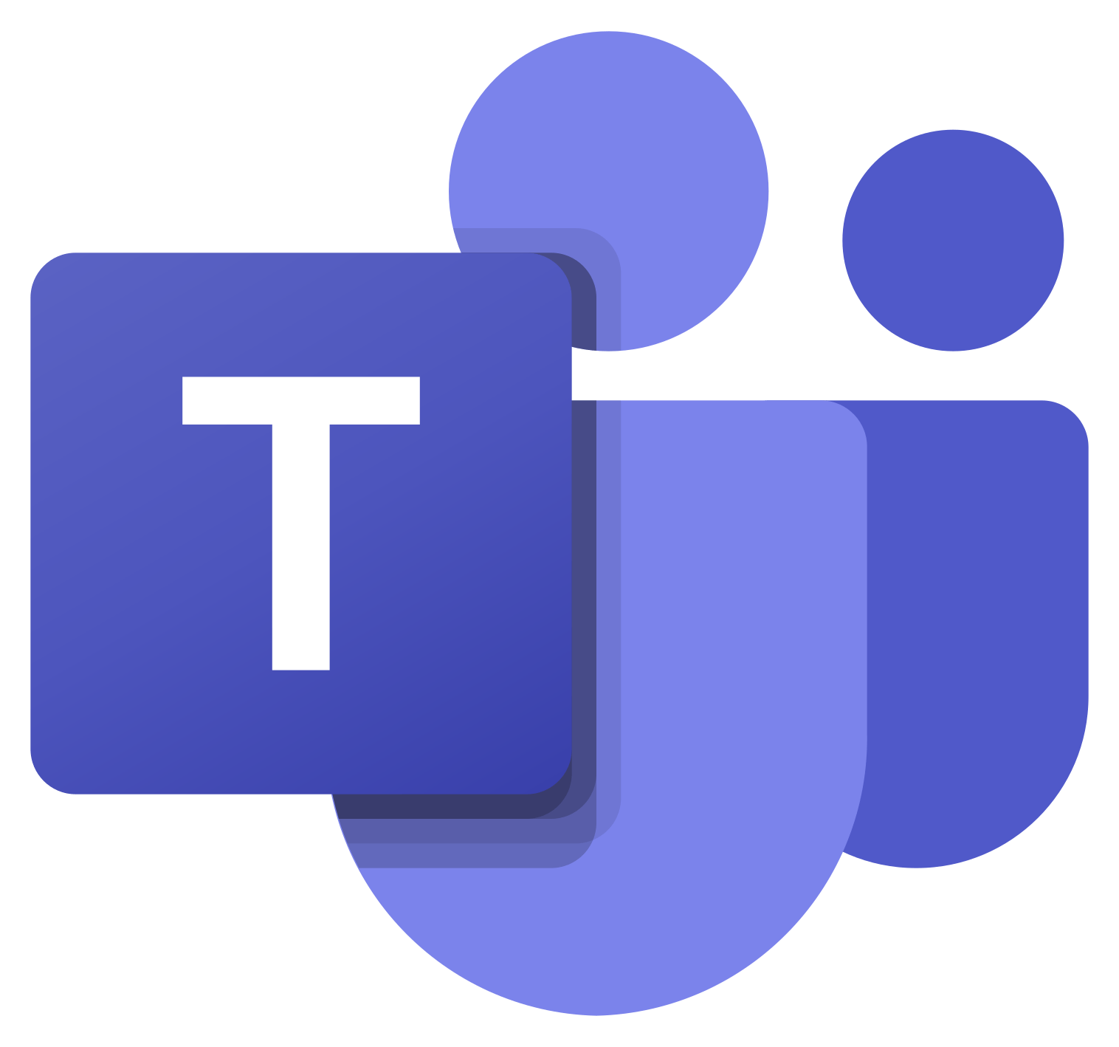





AI-powered User’s Guide
Accelerator
WHAT WE PROPOSE
AI-powered User’s Guide accelerator based on the MS Copilot Studio, integrated as a Bot in the Microsoft Teams application, can advance the onboarding process on any topic. A manager provides instructions in natural language, they are processed by the LLM from various knowledge bases, resulting in an interactive guide stored in the repository. During the interaction with the end-user, the accelerator constructs and executes the procedure based on a predefined interactive guide, addressing any user questions that arise. This solution aims to reduce onboarding time and enhance overall satisfaction, offering a more efficient experience for end-users within their familiar workspace toolset.
PROBLEM STATEMENT
The onboarding process frequently strains resources and reduces productivity in many organizations. Integrating newcomers often causes a productivity dip due to the time and resources required. Besides the organization faces the challenge of balancing the integration of new members with maintaining productivity. Also, post-release introductions of new functionalities can be overlooked, leading to poor feature adoption and client dissatisfaction.
Power Platform
Admin app
App data connector
App data repository
Manager
Channel app
Custom Copilots
Knowledge source connector
User
Knowledge source

Slide 6
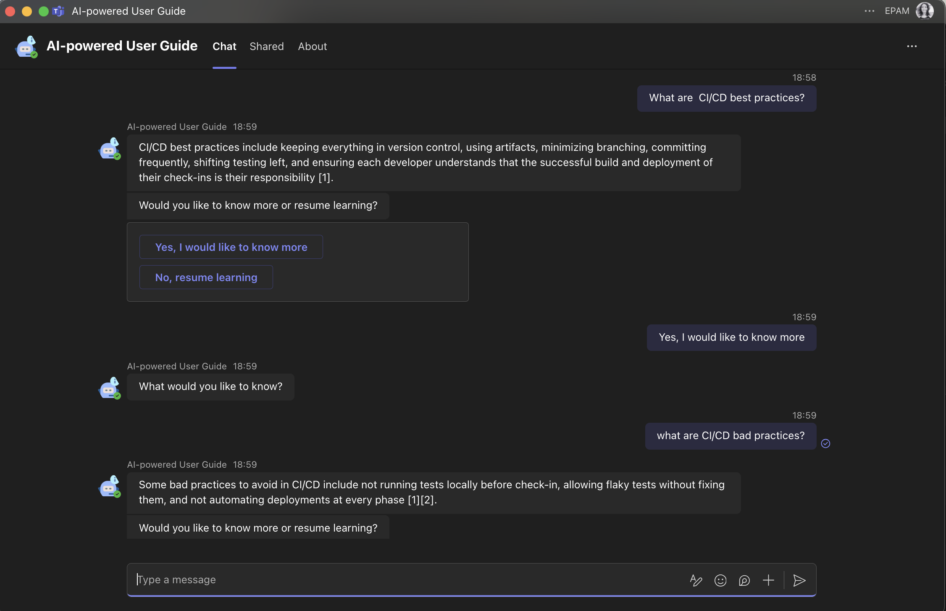
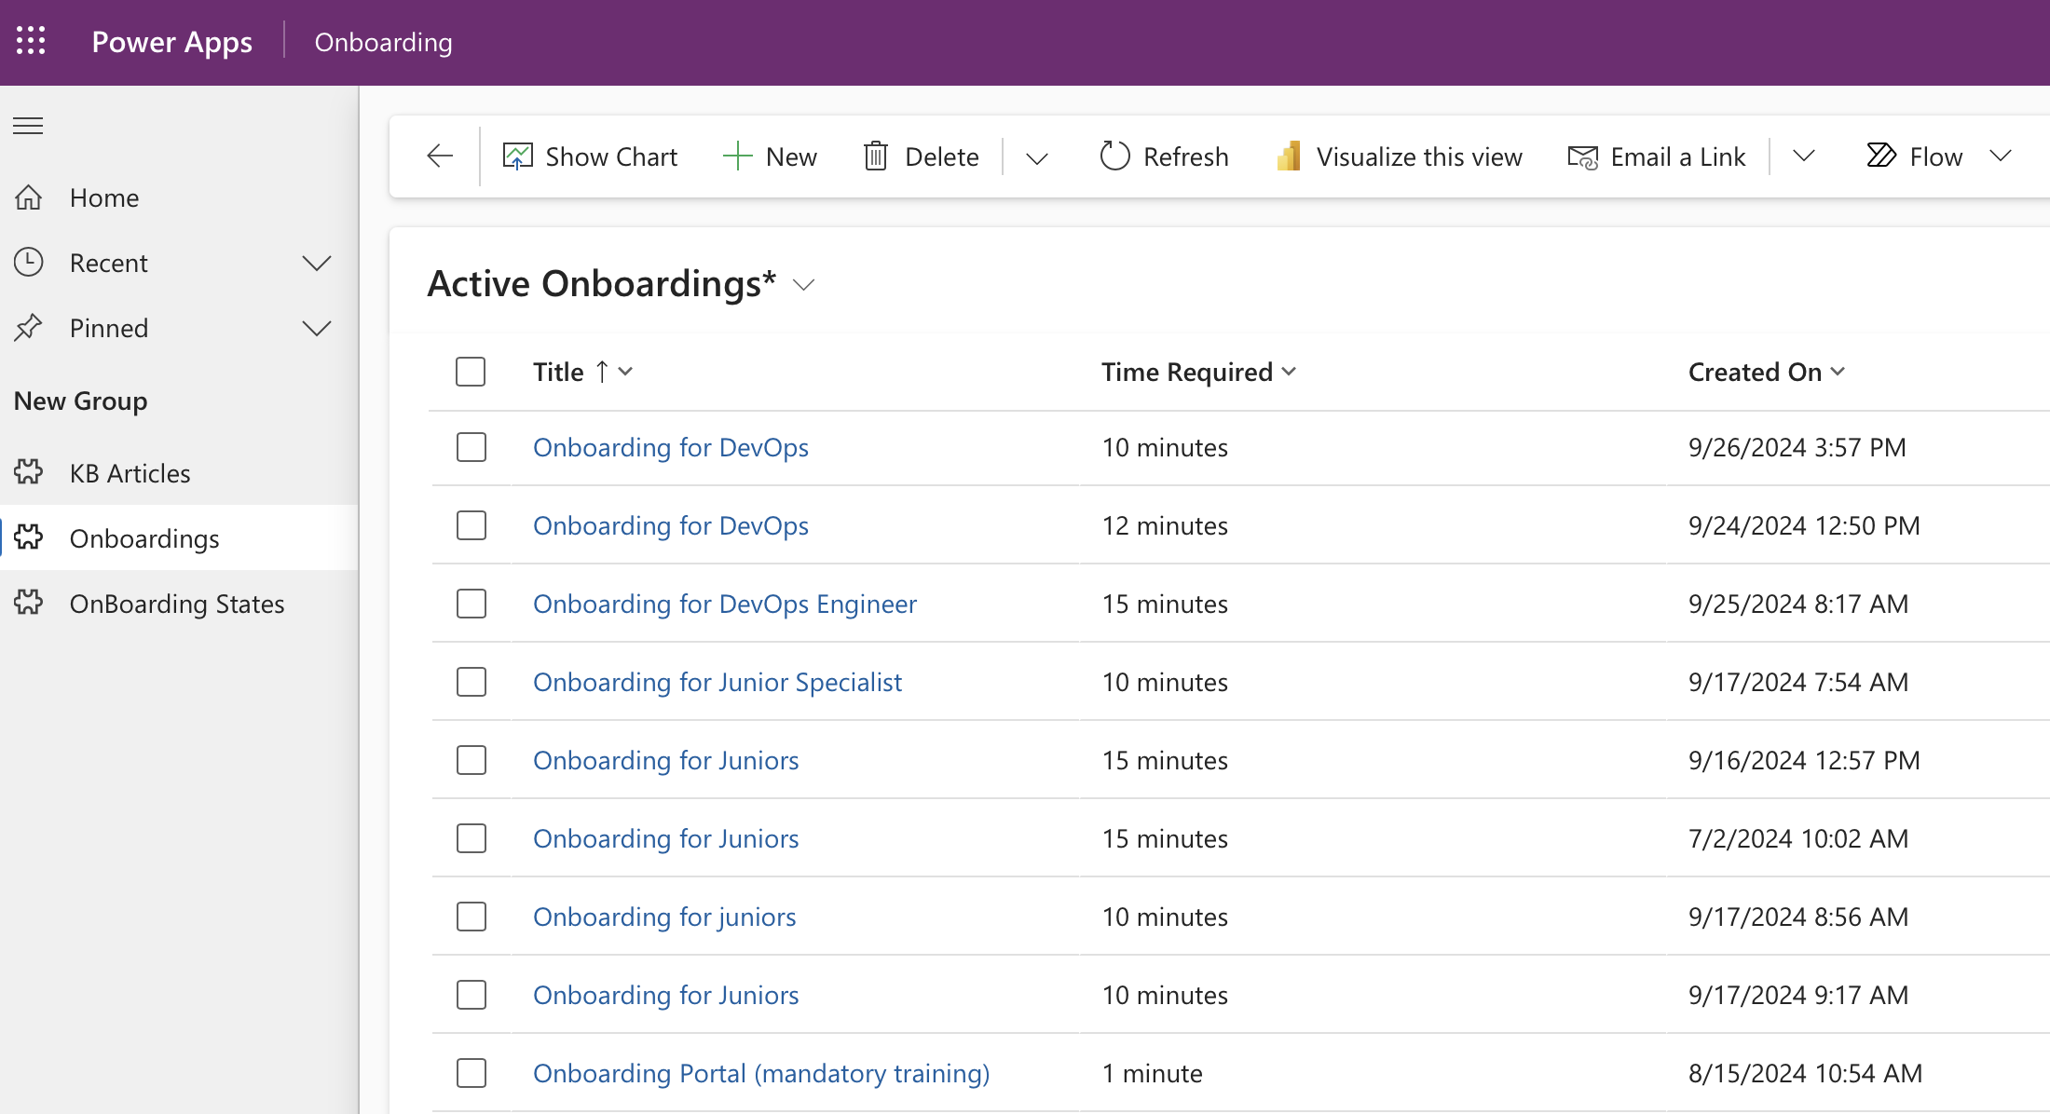
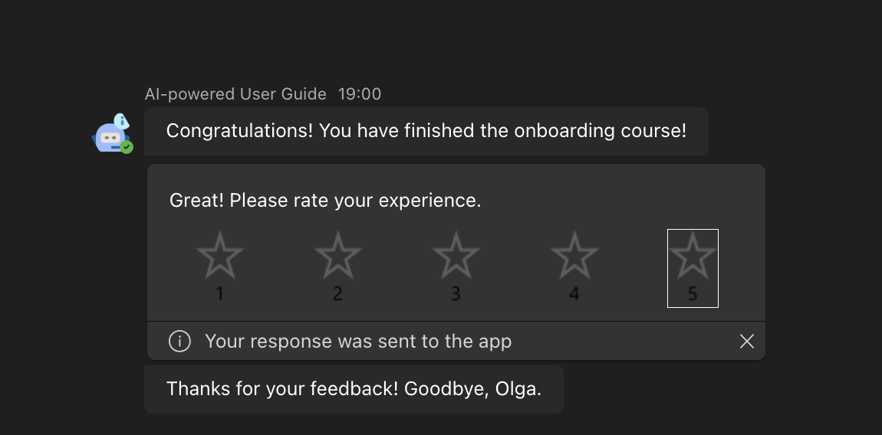
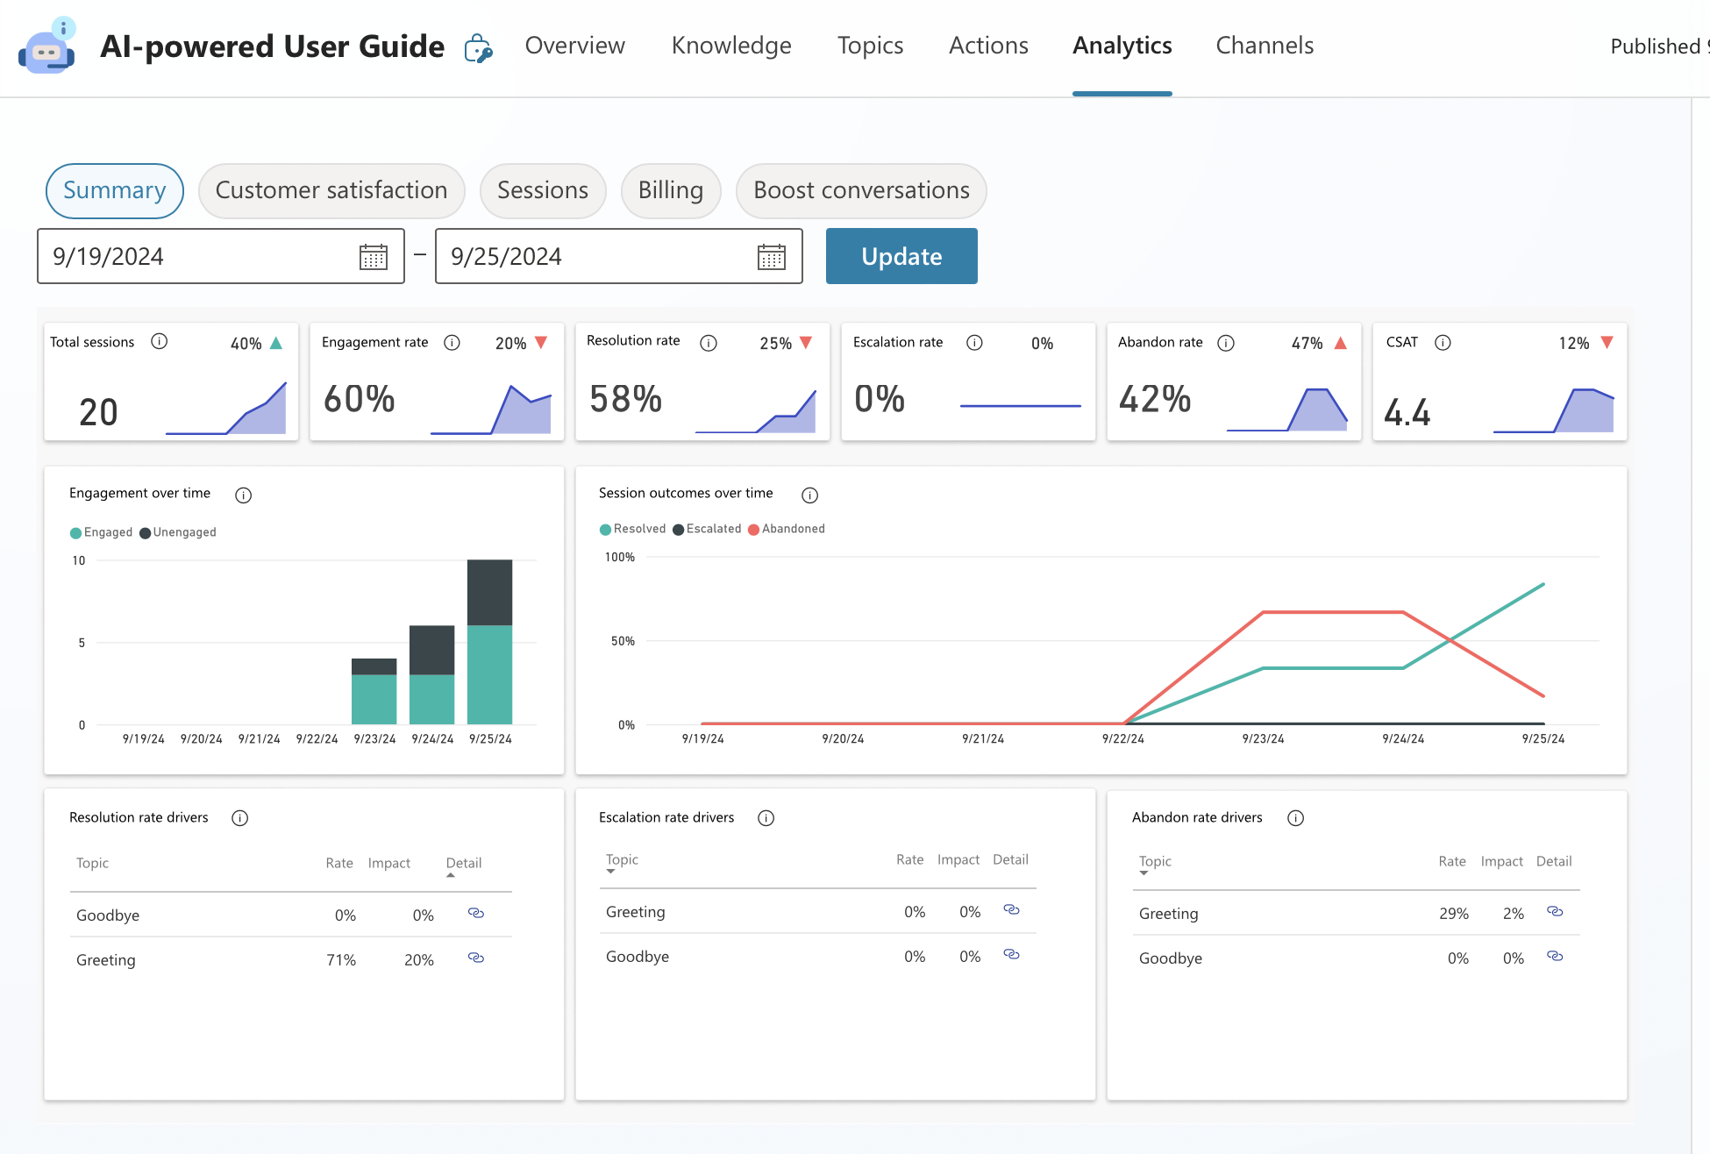
AI-powered User’s Guide Features
AI-Powered Content Creation: Managers create onboarding courses with AI assistance. The Bot proposes content from the knowledgebase, which managers can edit, approve, or cancel before finalizing.
Static Course Management: Approved courses are saved in a static state, ensuring consistent communication during execution. Managers can adjust content through the application as needed.
Course Assignment and Notifications: Managers assign courses to users, who receive push notifications in Microsoft Teams when new training is assigned, ensuring timely engagement.
Progress Tracking: The solution tracks user progress, allowing managers to monitor completion rates and identify areas needing attention.
Interactive User Support: Users ask questions via MS Teams, and Copilot retrieves accurate answers from SharePoint, Confluence, or other sources based on permissions. Users can rate sessions.
Source Linking: Copilot provides answers with direct links to original sources, ensuring transparency and easy access to detailed information.
Reporting and Analytics: Administrators access reports on satisfaction rates, engagement levels, and abandonment rates to measure the effectiveness of onboarding courses.

Slide 7
User’s Guide: Indicative Timeline and Costs of Implementation
The scope of the proposed implementation includes deployment and configuration activities in just 12 working days by 1 Functional Engineer.
DAY 0 | DAY 1 | DAY 2 | DAY 3 | DAY 4 | DAY 5 | DAY 6 | DAY 7 | DAY 8 | DAY 9 | DAY 10 | DAY 11 | DAY 12 | DAY N
DEPLOYMENT
Pre-conditions
on Client side: accesses and environments preparation based on the provided requirements
Preparation of List of 10 Specific questions (control-questions for the UAT)
SOLUTION CONFIGURATION
Solution Deployment
Connection of the bot to Microsoft SharePoint
Connection of the bot to Confluence (coordination on configuration of the Microsoft Graph API, connection of the bot to this pre-configured connector)
Deployment of the Data model
Configure the bot instructions (prompts) as bot name and description
TRAINING & TESTING
Key users and business administrator training
Testing & UAT
Bug fixing
PoC REVIEW
Review the results
Plan the future enhancements
POST-GO-LIVE SUPPORT
1 FTE Power Platform Functional Engineer
0,1 FTE Power Platform Delivery Manager
IMPLEMENTATION COST:
$ 8 000
THE TEAM:
Notes:
1.1. Base wireframes
1.2. Base Solution design
2.1. Solution with elements as developed increments (e.g. UI forms, automated flows, data storage, configured connectors, integrations, extensions, dashboards, reports, security roles, etc).
2.2. Imported data
4. Transferred Knowledge:
4.1. Source code
4.2. Base User stories

