Slide 1
Introducing AOS: Microservices deployment and orchestration solution for the Connected Car
July, 2019

Slide 2
Disruption IN THE AUTOMOTIVE INDUSTRY

Slide 3
Today automotive companies are faced with several types of disruptive forces like connectivity, electrification, automation and different new business models.
Manufacturers gradually shift focus to treat cars as “developer platforms” enabling applications to access data that previously was not possible.
MAJOR PARADIGM CHANGE IN THE AUTOMOTIVE SOFTWARE PLATFORM DEVELOPMENT

Slide 4
Top Priorities in Automotive
WHERE ORGANIZATIONS ARE INCREASING SPEND
Source: Gartner

Slide 5
New Revenue Streams in Mobility
PREDICTED MARKET SIZE 2030
MARKET SIZE TODAY
500B EUR
650B EUR
65%
93%
VEHICLE SALES
35%
Data-enabled services
7%
CONNECTED & MOBILITY
Shared Mobility

Slide 6
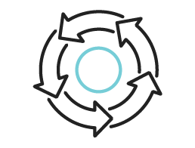
Turn Data to Services in The Vehicle
NEW BUSINESS MODELS
PREDICTIVE MAINTENANCE
FLEET MANAGEMENT
Incremental revenue due to bulk data sales
Differentiated services with fuel on demand
Linked product sales through positive experiences with customer service and support
Drive sales with more relevant, robust next gen products
Reduce warranty expense by identifying & implementing fixes faster
Reduce fuel & energy costs ensuring vehicle health
Improve customer satisfaction due to pre-emptive fixes
Reduce fuel and energy costs by monitoring by optimized routing
Improve vehicle uptime
Reduce accident rate
Increase product revenue and customer stickiness among fleet owners
Performance-based compensation with driver monitoring
Other Data Enabled Services
ECOMMERCE INSIDE THE VEHICLE
OTA UPDATES
CONCIERGE SERVICES
PERSONALIZED CONSUMER SERVICES
CAR SHARING MODELS

Slide 7
EPAM’S Software-First Approach for THE Connected Vehicle

Slide 8
EPAM PROVIDES AN ORHCESTRATION PLATFORM THAT ENABLES THE CAR’S CONNECTED SERVICES TO FUNCTION WITHOUT LEARNING EMBEDDED AND AUTOMOTIVE ALLOWING AUTOMOTIVE OEMS TO GROW THEIR SERVICES AND TO STAY AHEAD OF THE CURVE.

Slide 9
The need for an Orchestration Platform
WHO
GOAL
WHY
CONNECTED CAR PROJECT LEADERS AT OEMs & TIER1s
TO BECOME THE KUBERNETES FOR THE CAR
SERVICE ORCHESTRATION & MARKETPLACE WILL BE COMMODITISED
As service orchestration and application marketplace will be commoditised, OEMs should focus on what they do best, and let others bring in the platform orchestration knowledge.

Slide 10
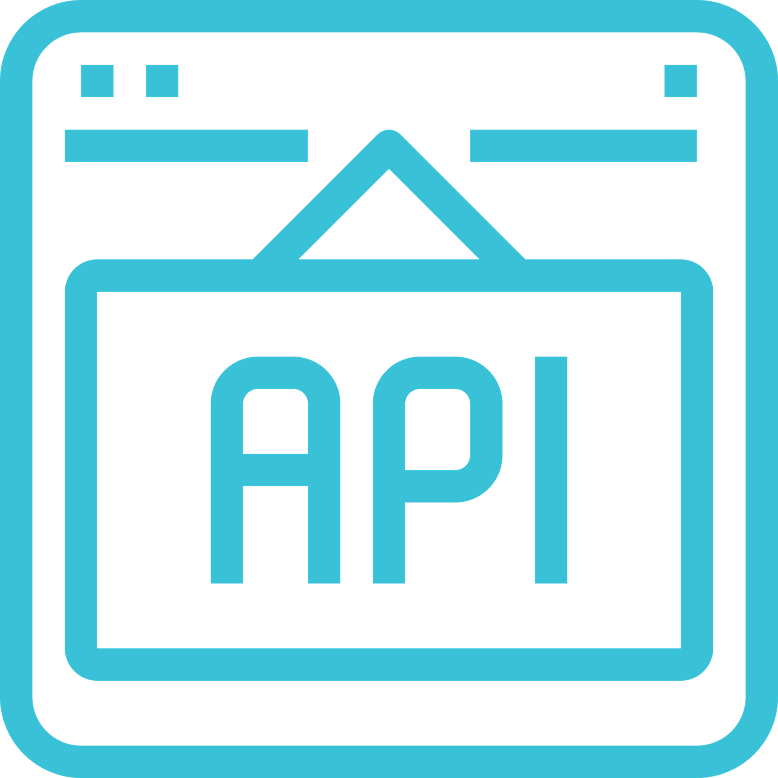
Microservices Deployment and Orchestration Platform
Monitoring & Control
Microservices deployment
What is Aos
Operation
OEM Aos Cloud
OEM
“Kubernetes” for vehicles.
Open source microservices deployment and orchestration platform.
Enabler of standard software development language, tools, and processes.
Vehicle Edge approach.
Microservice
deployment
Service Data
Service Provider Cloud
Operation
Service Provider
Aos
Delivery
OCI-Compliant Containers
AMQP Command & Control
Campaign Planning
Scaling
Security
System Isolation
Containers
Cloud Connection
Service Runtime Introspection
Multi-tenancy
Control Roles
Usage Roles
Vehicle Level Service Isolation
Local Storage Support
Vehicle access APIs
VIS Specification Support
FOTA Integration Support
SOTA Package Management
HW Provisioning Template
Development SDK
Modern SW Frameworks
Service Debugging Tools
Runtime Platform Alerts
Service Validation Tools

Slide 11
System high level architecture
Aos Cloud
Service Discovery
Vehicle
Gateway Cache
Session
Cache
Vehicle >
Cloud Channel
Vehicle Gateway Manager
Vehicle Gateway
Service
Bus
Cloud >
Vehicle Channel
Aos Core (Vehicle)
Backend
Service
Services
Manager
Admin UI/API
OEM /
Service Provider
Operational Database
Services
Service
CDN
OEM/Service Providers Integration
Blob
Storage

Slide 12
What do we offer
EPAM HELPS OEMS STAY AHEAD OF THE CURVE WITH E2E SERVICES
A competitive subscription based SaaS platform with the option to deploy on-premises or to the cloud.
EPAM provides the AOS platform and engineering services to integrate it within the existing car ecosystem.
Deployment and security updates delivered in a timely fashion.
AOS allows pilot projects to be run directly on the real vehicle.
The AOS platform will complement your internal programs extending your possibilities to grow in the services area.

Slide 13
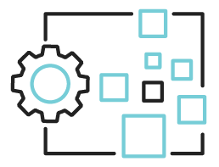
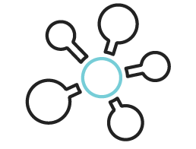
Business Value of AOS
CAR OEM
Car OEM CONNECTED CAR SERVICES DIVISION
Revenue
New revenue streams
New markets & business cases
Control& Interface
End-to-end control
Cloud-to-edge approach
Integration & Complexity
Software car
No hardware integration
Time & Effort
Run as a service
Time to market

Slide 14
Business Model
Aos Core
Aos cloud
COMMERCIAL-FRIENDLY OPEN SOURCE LICENSES
NRE FOR INTEGRATION
ROYALTY FREE
NON-REDISTRIBUTION SOURCE-AVAILABLE LICENSE
NRE FOR INTEGRATION AND CUSTOMIZATION
CLOUD AGNOSTIC, SAAS OPERATION MODEL
VOLUME BASED SUBSCRIPTION FEE FOR MAINTENANCE AND SECURITY UPDATES FOR AOS CORE AND CLOUD
TRANSFER OF OPERATION IS POSSIBLE WITH SPECIAL AGREEMENT

Slide 15
MAJOR AOS FEATURES

Slide 16
Delivery
OCI-COMPLIANT CONTAINERS
AMQP COMMAND & CONTROL
CAMPAIGN PLANNING
SCALING
Lightweight due to use of rootfs-preinstalled system layers
Validation & dependency checking logic is moved upwards
Same toolset used by OCI, Docker and others
Remote container management
Remote system & services monitoring
Isolated and independent instances for security and fast scaling
Supporting QoS for rolling out of updates
Different strategies: canary, blue-green, rolling
Rules planning (geographies, time of day, usage, etc.)
System designed to support scaling to millions of vehicles in near-realtime avoiding traditional IoT GW design bottlenecks

Slide 17
Security
SYSTEM ISOLATION
CONTAINERS
CLOUD CONNECTION
Service Runtime Introspection
Cloud services system is running in a fully isolated virtual machine: no HW access, read-only root FS, secure & isolated services storage, firewalled network, HW-backed secrets storage & crypto functions
Vehicle information is accessible through W3C Automotive APIs implemented in a “trusted” vehicle domain
Container level security provided by hardened OS kernel and system services
Attack surface of the container management tools themselves is minimal
Loopholes in the container configuration profiles addressed by edge-level validation
Every device connects to cloud through fully encrypted AMQP channel with mutual TLS authentication based on certificates
Package updates are downloaded through CDNs via HTTPS (server-side TLS) using unique temporary access tokens
Each package is signed and encrypted
Agent-less monitoring of the runtime state of a system-level virtual machine with service containers – as a tool of last resort for security if all barriers are broken
Ability to extend with custom algorithms and patterns for behavioral introspection

Slide 18
Multi-tenancy
CONTROL ROLES
USAGE ROLES
VEHICLE LEVEL SERVICE ISOLATION
Local storage support
Admin for system management
OEM for vehicles and users management with special roles supporting provisioning
Service Provider for services management with special roles supporting deployment
Each role's users may have different access rights
Driver services for person behind the wheel allowing only a single active per vehicle
Business user services for active businesses allowing multiple active users per vehicle
Each service is running in its own configuration space
Each service has quotas on RAM/CPU/Network/Storage usage to reduce interference
Each service has its own ACL configuration set for API access
Complex techniques for fast load & security: caching, TTL, etc.
Auto migrating service container configuration space (state) when user migrate between vehicles
Ability to "reset" and apply "state" configuration changes from cloud per service

Slide 19
Vehicle low level APIs
VIS Specification support
FOTA integration support
SOTA package management
HW Provisioning Template
API can be split into tiers allowing differentiation of services by access type (requested similar to quota)
Fully aware of possible protocol extension
Other protocols can be added (ViWi, ExVe, etc.)
Support for upgrading system firmware images in a separate non-interfering flow
Integration with vendor-provided flashing mechanisms needed
More strict security comparing to services delivery
Support for adding dependencies in a controlled way
Implementation for Aos Core updates – can be re-used for other system domains
Support for separate packages distribution (not images like with FOTA) for higher granularity of deployments
Support for unique HW IDs
Full implementation for provisioning flow available for reuse
Integrated with OEM users and roles

Slide 20
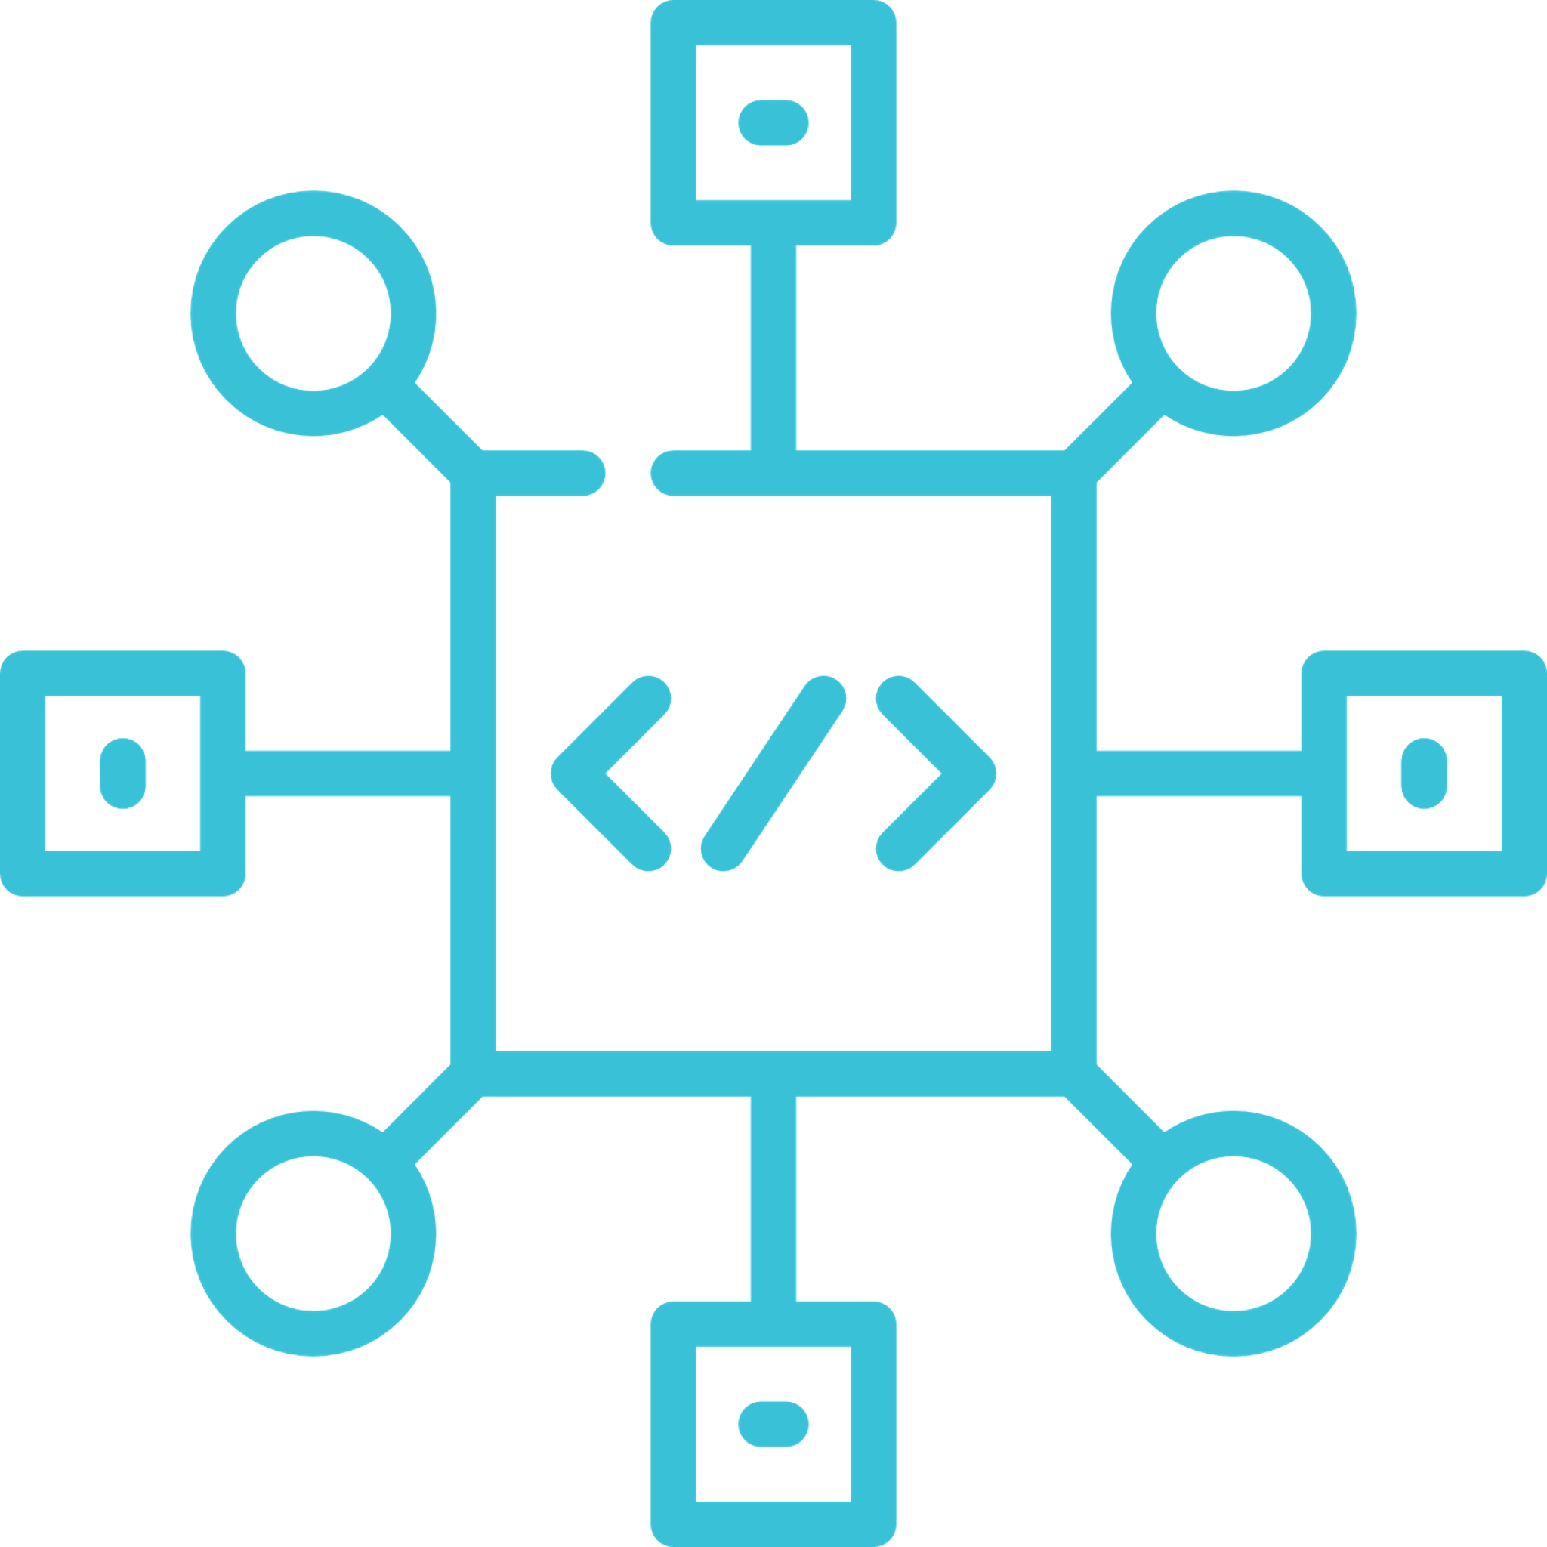
Development SDK
Modern SW Frameworks
Service Debugging Tools
Runtime Platform Alerts
Service Validation Tools
Python and node.JS based services are fully supported on the platform
Providing "generic" set of libraries and packages for support
Service debugging added for Service Providers to catch issues with service runtime and deployment
For security reasons, runtime debugging is limited and not allowed direct interaction
Platform alerts implemented for OEM notification of quota exhaustion or different system failures
Alerts allow understanding quota issues, crashes, etc.
Validation tools to check for dependencies (missing or version mismatch) – libraries, frameworks, etc.
Based on multiple service validation output system package manager (SOTA) can add more libraries or packages

Slide 21
Thank You!
BHUVAN MALHAN SENIOR BUSINESS DEVELOPMENT MANAGER
Email: Bhuvan_Malhan@Epam.com
Tel: +491737580657

